Slide 1
Window 7 Memory Forensics

Slide 2
Windows Volatile Memory (RAM)

Slide 3
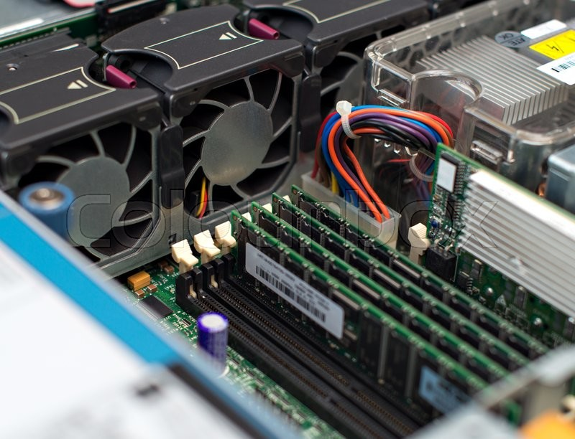
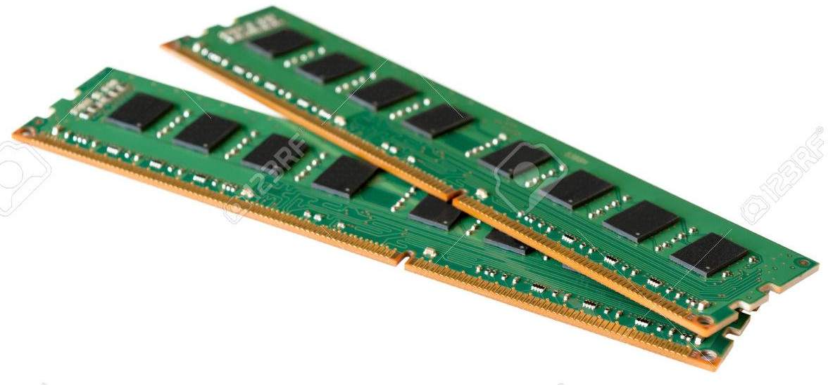
RAM
random access memory
is a form of computer data storage
Semiconductor memory is VOLATILE
it need continued electrical current to maintain data
Temporary – because there is too little of it

Slide 4
RAM
Hold data and instructions ready for use by the CPU
Anything we want the computer to do must be brought into the computer’s memory first

Slide 5
storage media vs RAM
RAM stores information
running process, incognito browsing sessions, clipboard data , information stored in plain text files and much more.
Essential for malware analysis
running process information, services, system service behavior, registry updates, network traffic
Other artifacts
browsing sessions (Incognito Sessions) , passwords, accessed files and multimedia, Chats/Running Application stored data

Slide 6
Pre- Acquisition Process
Host machine should not be connected to any external network
Disconnect LAN/WIFI/Bluetooth connections by putting the device in airplane mode
Ensure the device is unlocked without installing any password bypassing module
Remove any external connected devices
Host machine should be connected to a stable power source

Slide 7
steps for acquisition
Determine the state of the machine
Identify the operating system
Check for authentic device access
Insert acquisition media
Perform Volatile Memory Dump
Collect SWAP, PAGEFILE.sys and system protected files
Hash and verify the acquired files
Create Investigator copies

Slide 8
Memory acquisition

Slide 9
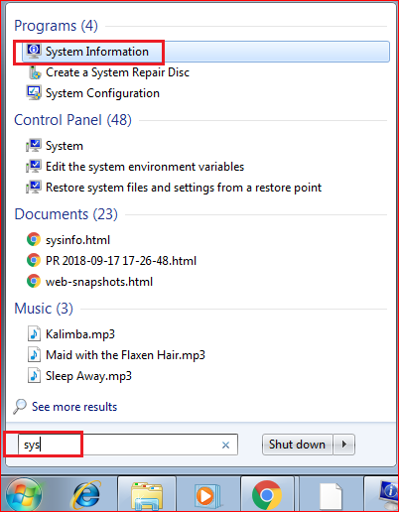
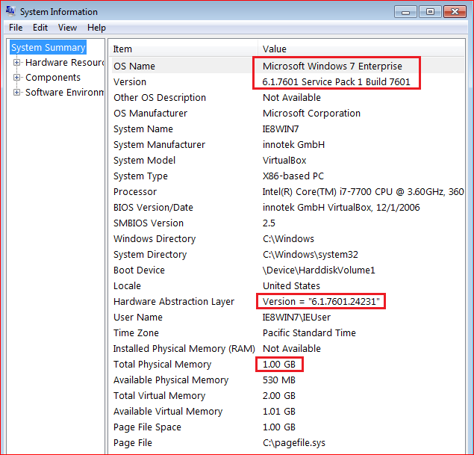
VM Windows 7 SP 1 system information

Slide 10
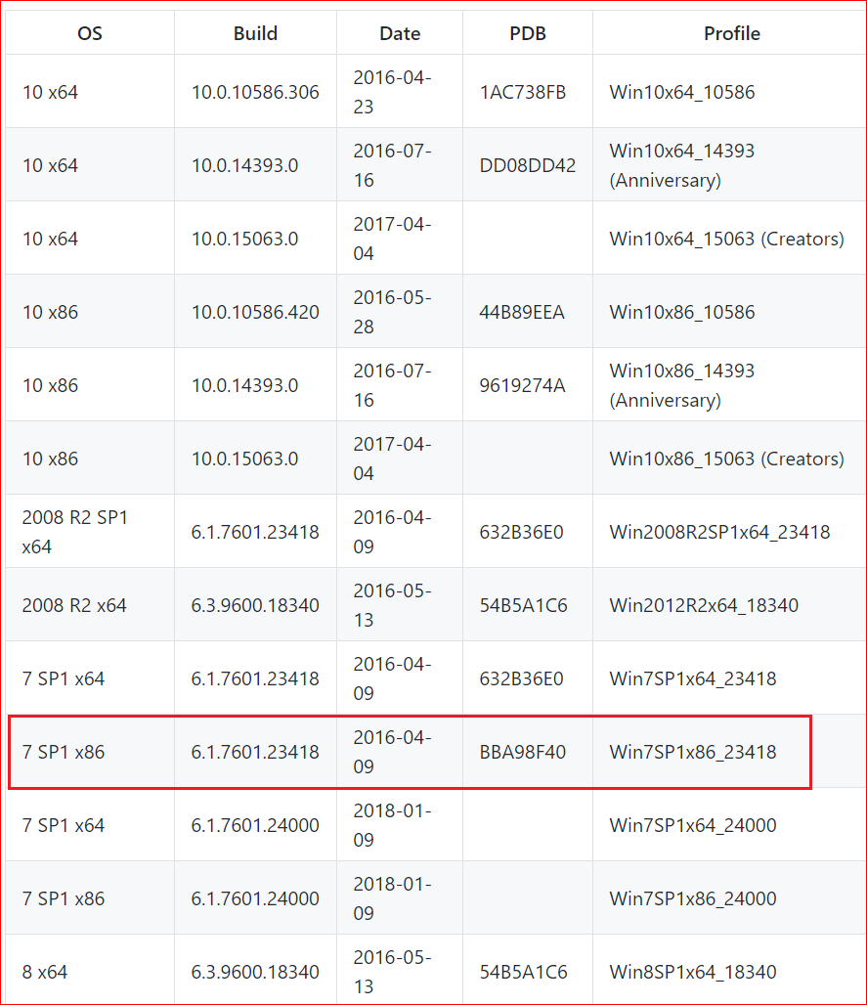
Win Profiles supported by software

Slide 11
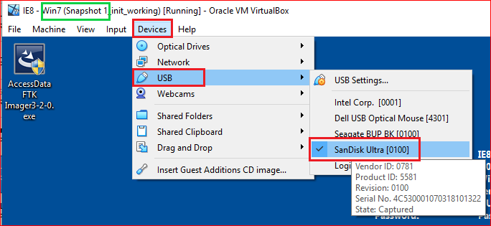
Prepare a USB to save memory information

Slide 12
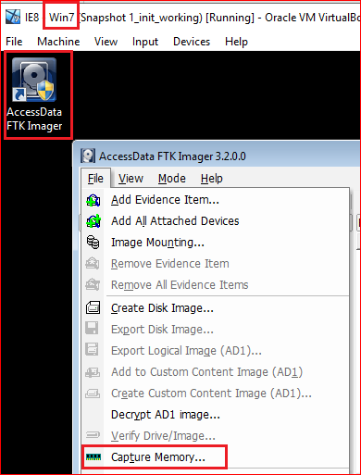
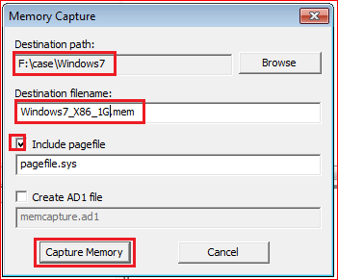

Slide 13
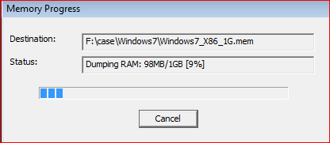
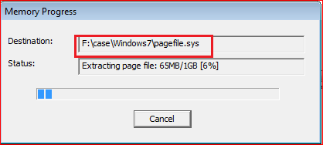
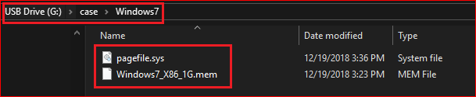

Slide 14
Move captured Memory to Kali
USB (optional)
Download (we use in the lab)

Slide 15
Move captured memory from a USB to Kali
Optional

Slide 16
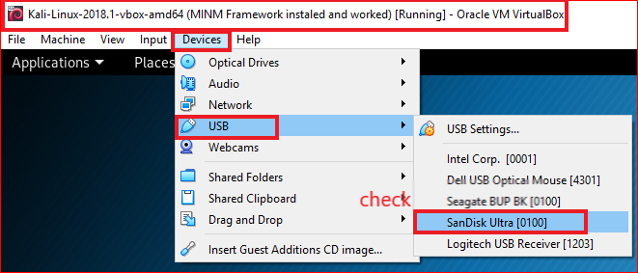

Slide 17
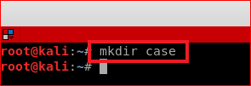
Prepare a working directory in Kali

Slide 18
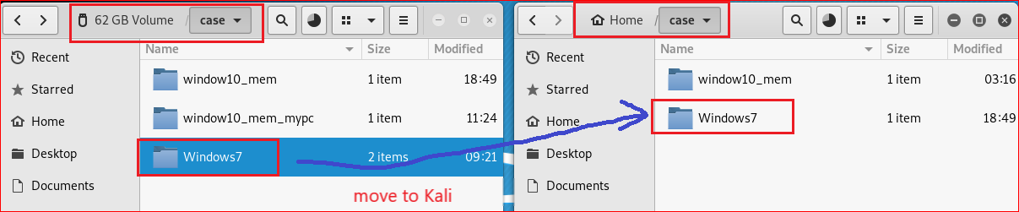
Move memory information from USB to Kali

Slide 19
Download captured memory to Kali

Slide 20
Prepare a working directory in Kali

Slide 21
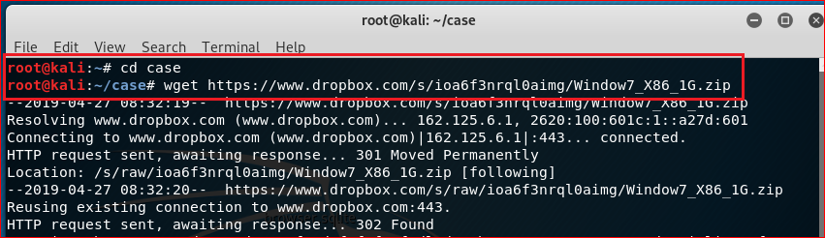
https://www.dropbox.com/s/ioa6f3nrql0aimg/Window7_X86_1G.zip

Slide 22
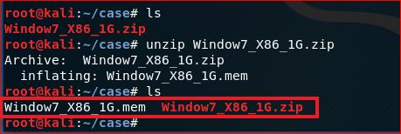
Verify your have Window7_X86.mem

Slide 23
Memory Analysis

Slide 24
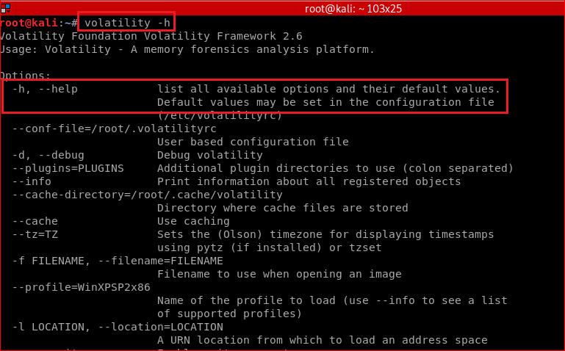
Display global command line options

Slide 25
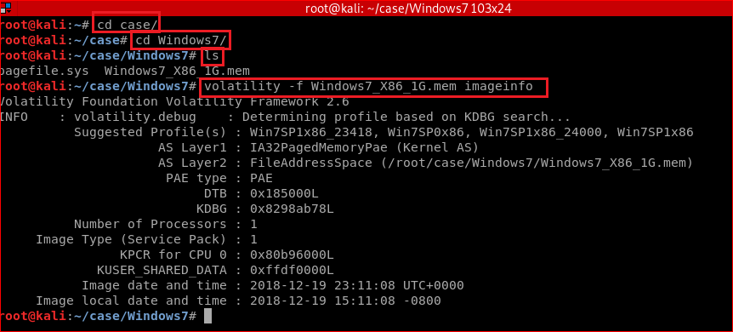
Identify information for the image using imageinfo plugin

Slide 26
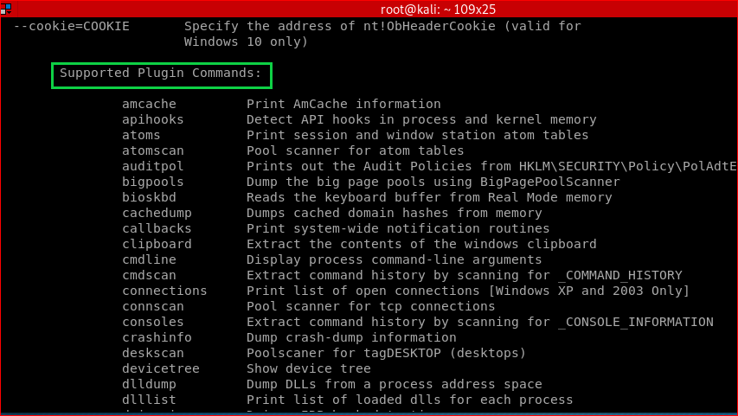
Other plugins

Slide 27
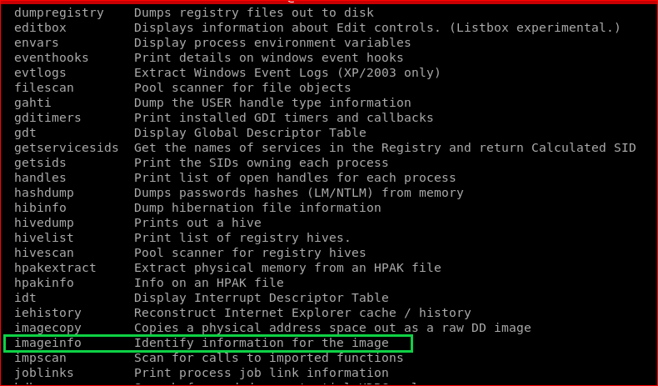

Slide 28
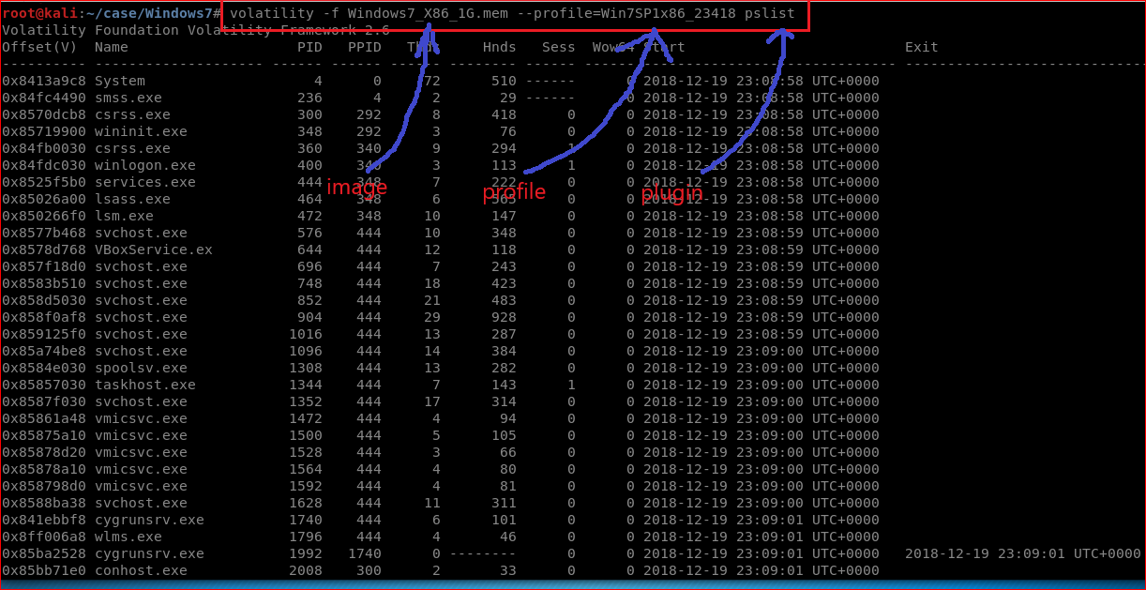
Print all running processes

Slide 29
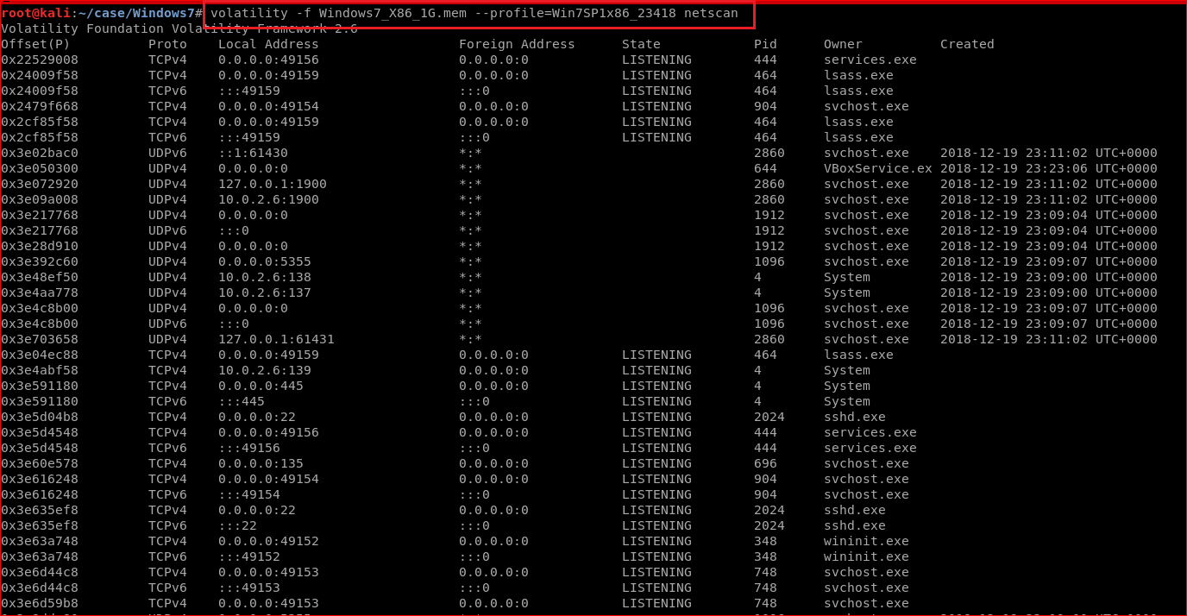
scan for network artifacts

Slide 30
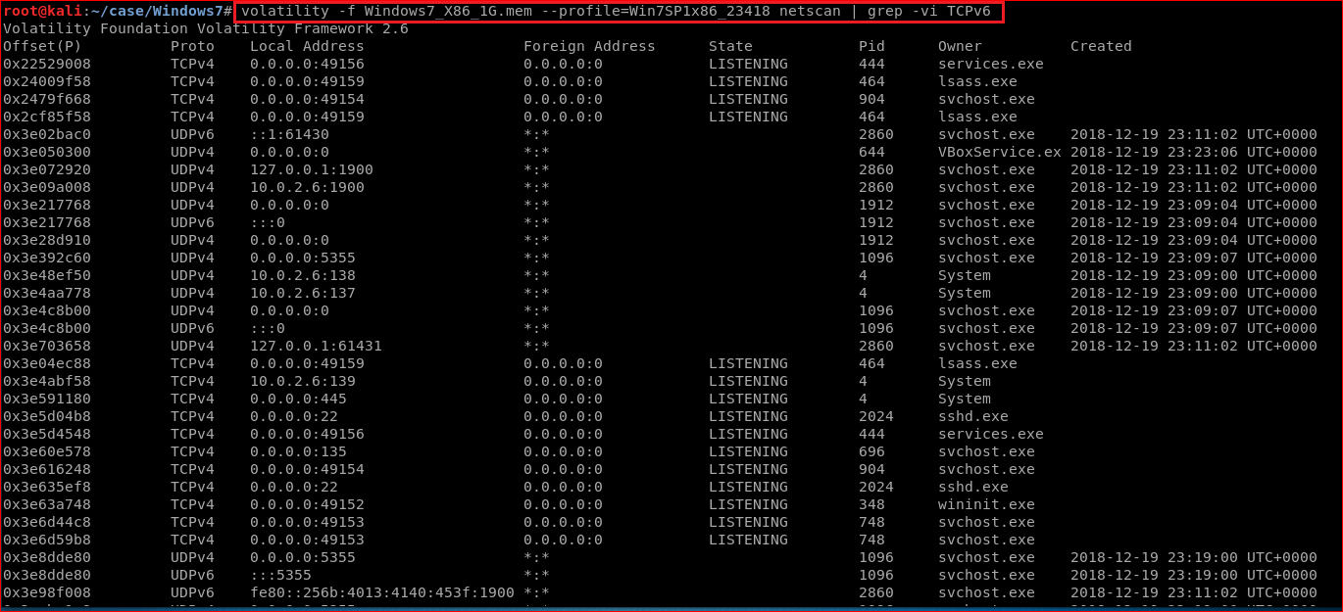
Fillet out TCPv6: grep –vi TCPv6

Slide 31
Listing Hidden or terminated process

Slide 32
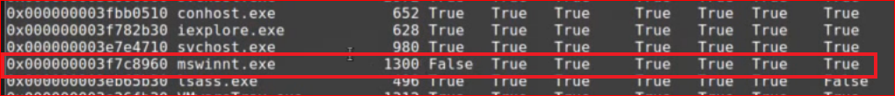
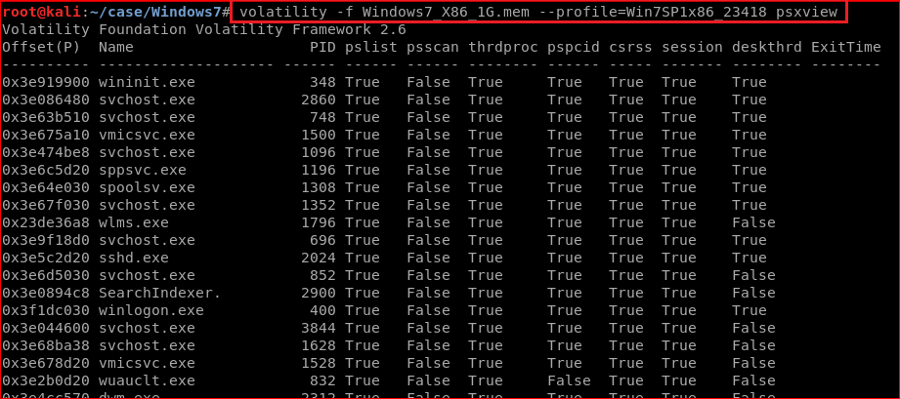
Cross reference processes with various lists (clues for malware)
Pslist false (not listed) and shows in other process

Slide 33
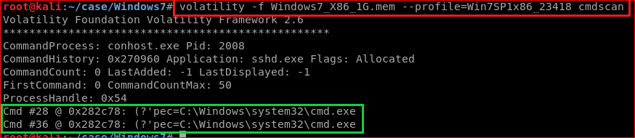
Recover command history
Notes:
https://www.andreafortuna.org/cybersecurity/volatility-my-own-cheatsheet-part-2-processes-and-dlls/

Slide 34
Other interesting functions
volatility -f memdumpWin7.mem --profile=Win7SP1x86_23418 consoles
Not only show cmd history, but screen information
volatility -f memdumpWin7.mem --profile=Win7SP1x86_23418 evtlogs
Not support this profile
There is also an option (--save-evt) to dump raw event logs for parsing with external tools:
--profile=WinXPSP2x64 evtlogs --save-evt -D output
volatility -f memdumpWin7.mem --profile=Win7SP1x86_23418 iehistory > output.txt
iehistory

Slide 35
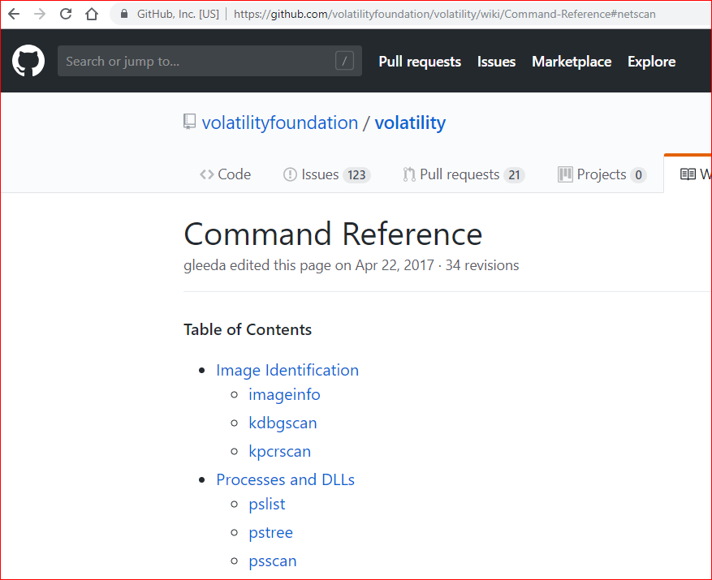
Command Reference

Slide 36
Process Limitations

Slide 37
Limitation
A locked machine with limited access cannot be utilized for volatile memory analysis .
The unlocking procedure will create changes to the system data and can cause system instability.

Slide 38
mobile device platforms
Memory dump is available only for the devices having administrative access or privileges in simple terms, device has to be rooted or jailbroken.
Memory dump is specific to the user account it has been accessed with, the RAM contents are available for only the logged in user.

Slide 39
Your work

Slide 40
scenario
Open IE
Download https://www.dropbox.com/s/40ak15mk5xr8hvk/how_to_crack_pwd_123.pdf
Open Windows Prompt
Copy how_to_crack_pwd_123.pdf to a USB

Slide 41
Your goal is to find evidence in memory

Slide 42
Reference
https://lucideustech.blogspot.com/2018/01/windows-volatile-memory-acquisition.html
https://www.youtube.com/watch?v=1OxR4KLj-4I
https://github.com/volatilityfoundation/volatility
https://github.com/volatilityfoundation/volatility/wiki/Volatility-Usage
https://github.com/volatilityfoundation/volatility/wiki
https://eforensicsmag.com/finding-advanced-malware-using-volatility/
https://resources.infosecinstitute.com/memory-forensics-and-analysis-using-volatility/#gref
https://www.andreafortuna.org/cybersecurity/volatility-my-own-cheatsheet-part-2-processes-and-dlls/

